Slide 1
Introduction to Unsupervised Learning

Slide 2
Outline
Supervised vs Unsupervised Learning
How unsupervised Learning works
Approaches of Unsupervised Learning
Types of unsupervised problems

Slide 3
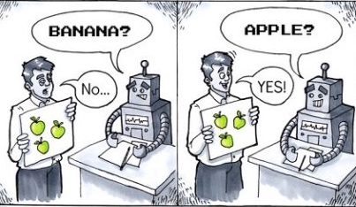
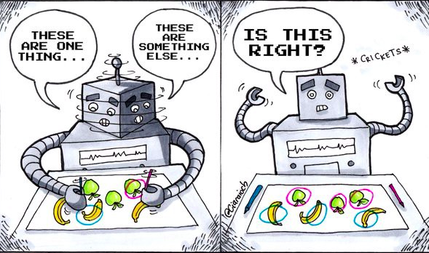
Supervised Learning
Unsupervised Learning

Slide 4



Supervised Learning | Unsupervised Learning
Computer learns by making use of labeled data | Computer learns by making use of unlabeled data
Requires manual annotation of data | Does not require annotation of data
Apple
???
Mango
Grapes
???
???

Slide 5

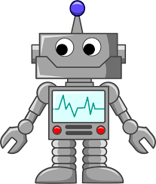
Why do we need to use unlabeled data?

Slide 6
Why do we need to annotate data?

Slide 7
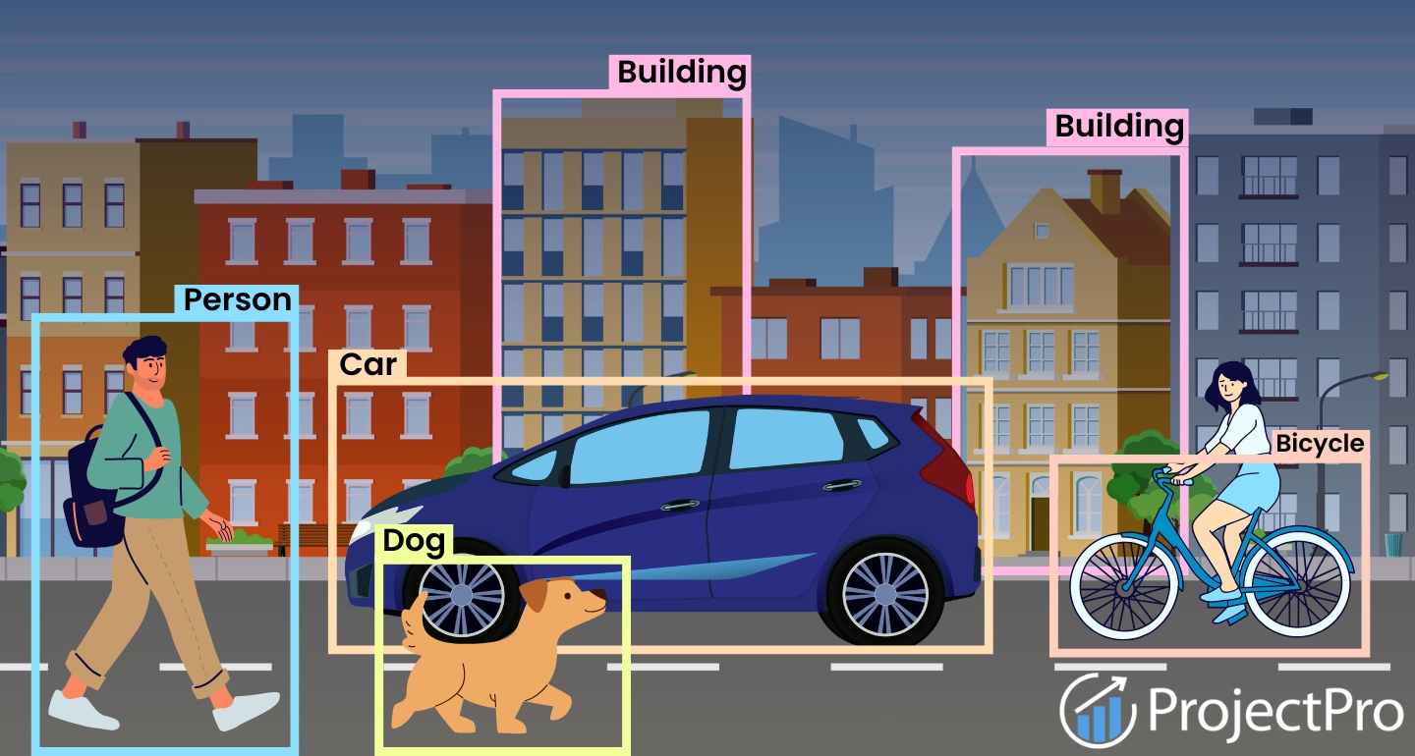
Data Annotation
The process of labeling data such as text, images, audio or video so that it can be used to train machine learning models.

Slide 8
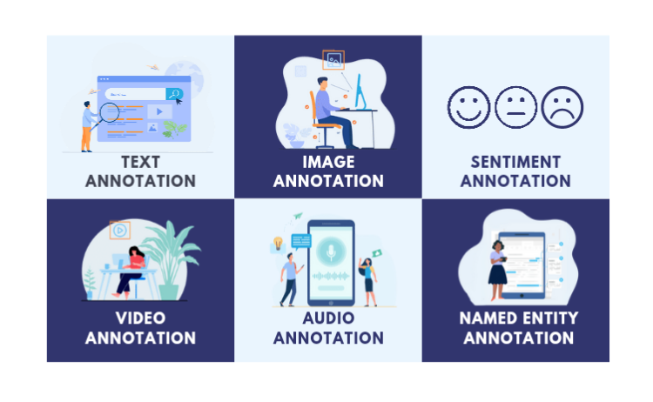
Types of Data Annotation

Slide 9
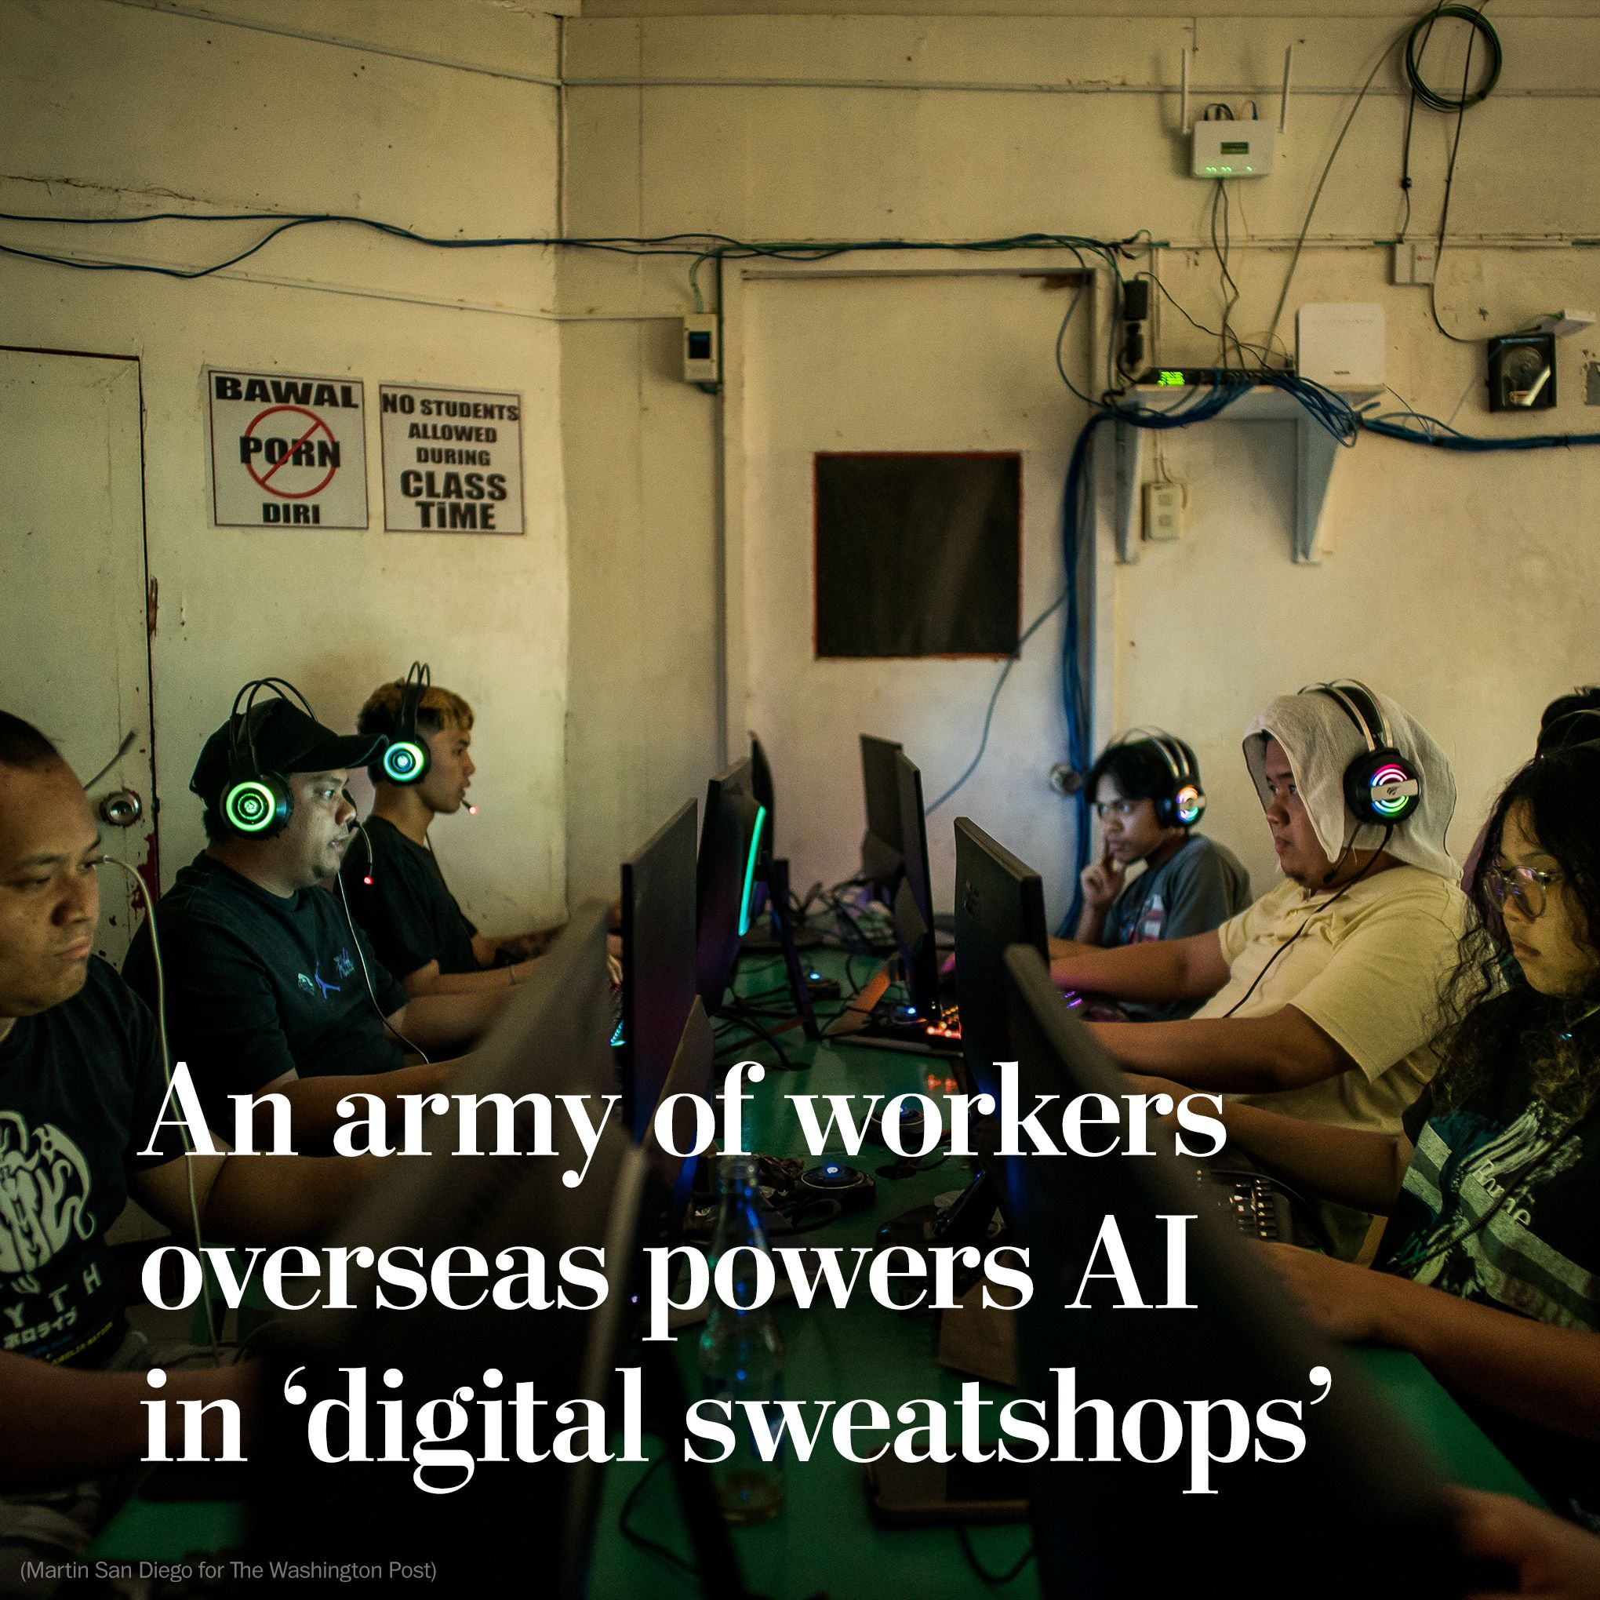
Why do we need to use unlabeled data?
The cost of annotating data varies and is very labor intensive.
Some annotation tasks such as labeling medical images costs higher because it requires domain expertise.

Slide 10
Why do we need to use unlabeled data?
Unfortunately, companies exploit people from the global south and pay these unregulated workers at extremely low rates or sometimes do not pay them at all.

Slide 11
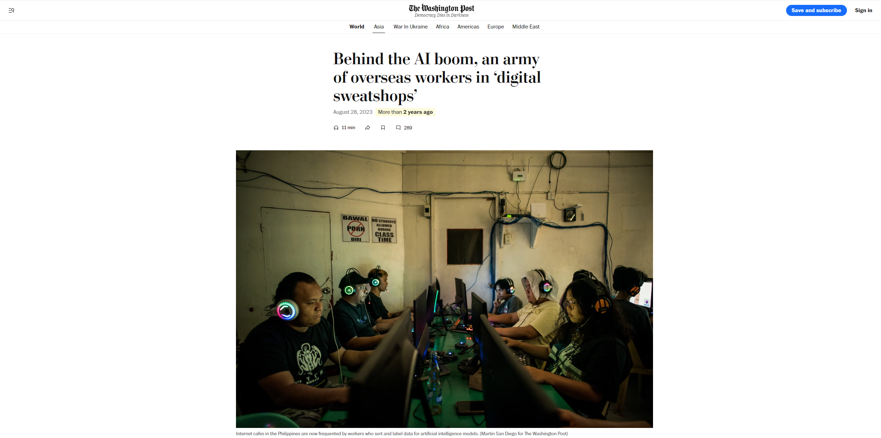
https://www.washingtonpost.com/world/2023/08/28/scale-ai-remotasks-philippines-artificial-intelligence/

Slide 12
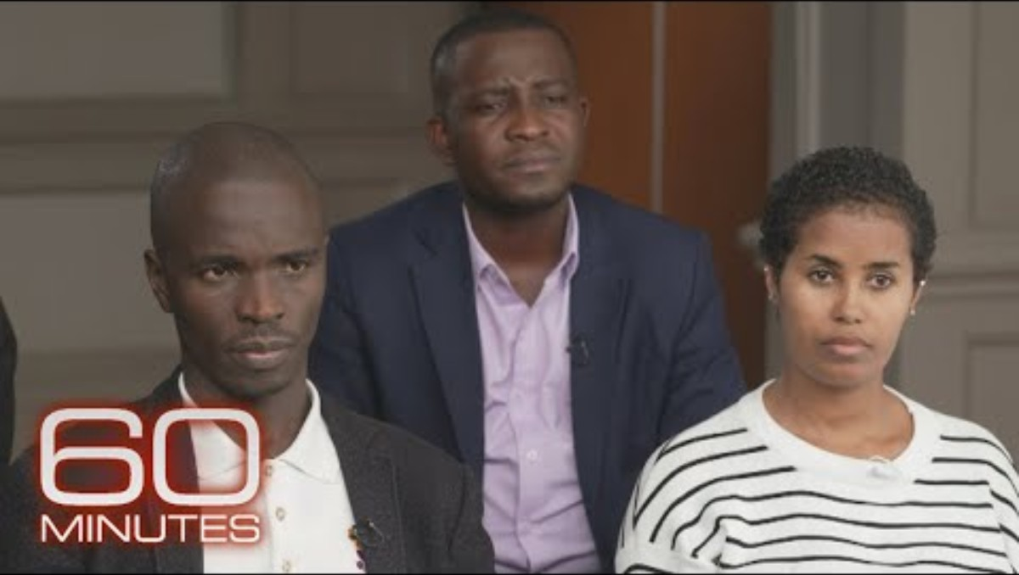
The human cost of training AI

Slide 13
If the data is unlabeled, how will the model learn?

Slide 14
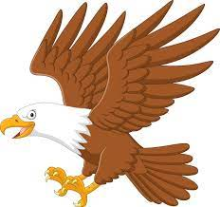
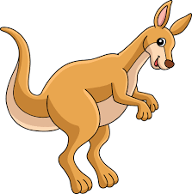
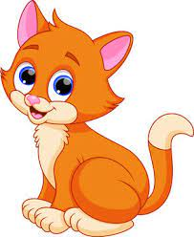
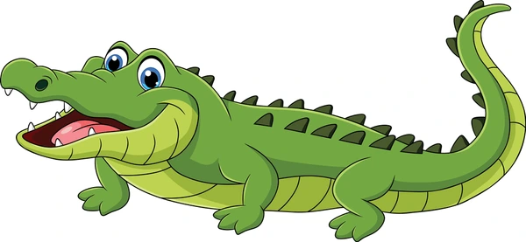
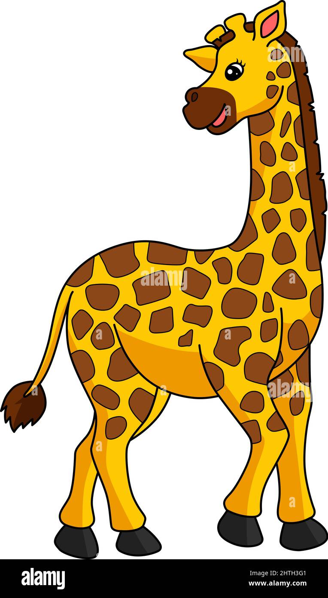

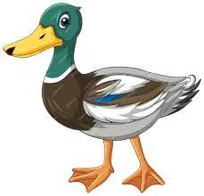
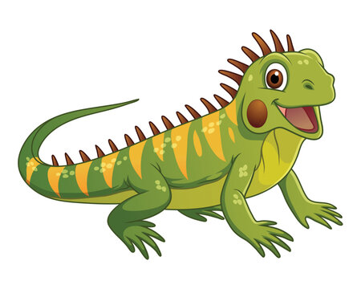
For example, if we have an unlabeled dataset of images of animals and we would like train a model that classifies if an animal is a bird, a reptile or a mammal

Slide 15
Since our data is unlabeled and we do not have a way of knowing what class they belong to..

Slide 16
We could start by finding features that the animals may have in common.

Slide 17
For example, since all birds have beaks and feathers, we can start looking at each image and see if some images have beaks and feathers.

Slide 18
If an image have these features, we group them together

Slide 20
Next, since reptiles have scales, we look at each image and check if they have this feature.

Slide 21
If an image have this feature, we group them together

Slide 23
And since mammals all have fur, we look at each image and check if they have this feature.

Slide 24
If an image have this feature, we group them together

Slide 25
Group with feathers
Group with scales
Group with fur
We now have grouped each image and created three groups

Slide 26
Group with feathers
Group with scales
Group with fur
We now have grouped each image and created three groups

Slide 27
Group with feathers
Group with scales
Group with fur
This process of grouping similar objects together is called clustering

Slide 28
Group with feathers
Group with scales
Group with fur
In clustering, a group of similar objects is called a cluster.

Slide 29
Group with feathers
Group with scales
Group with fur
Similar objects are grouped into one cluster and are different from objects in another cluster.

Slide 30
Group with feathers
Group with scales
Group with fur
Clustering is one of the main approaches used in supervised learning.

Slide 31
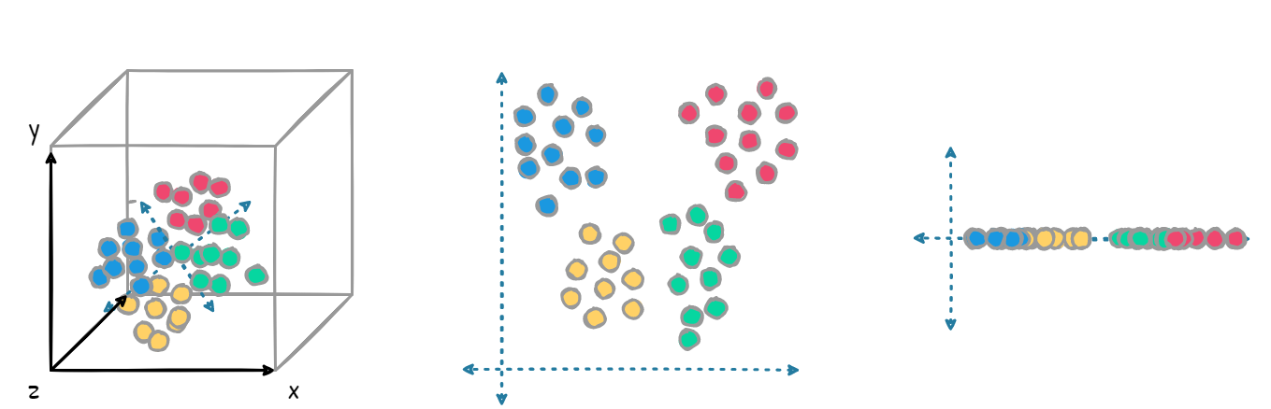
Dimensionality Reduction
Clustering
Other unsupervised learning approaches include dimensionality reduction and association rule learning.

Slide 32
Other unsupervised learning approaches include dimensionality reduction..

Slide 33
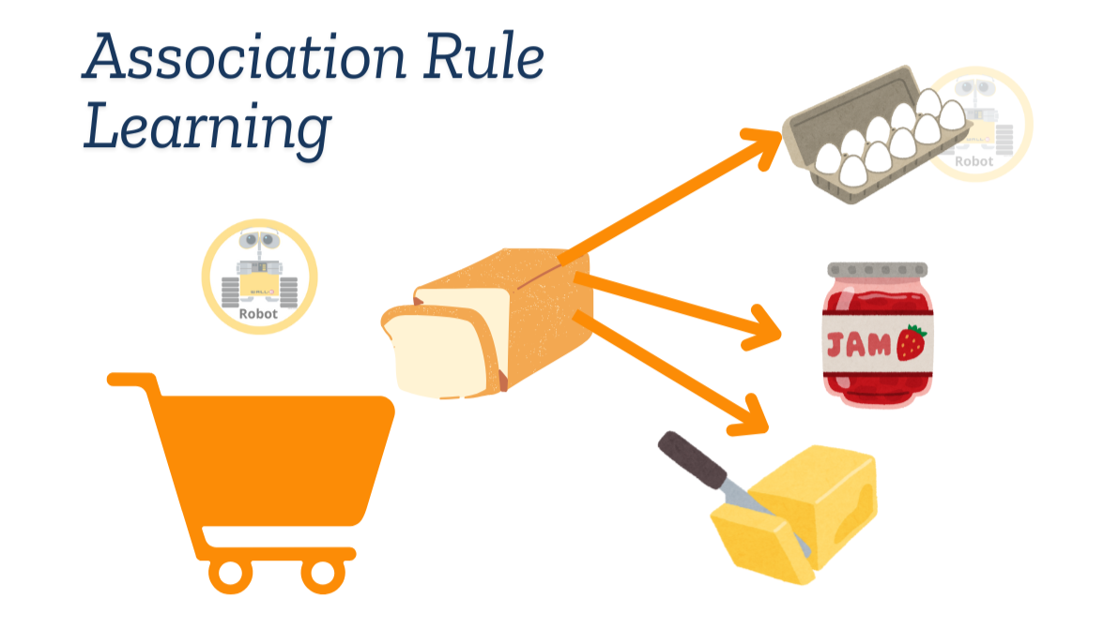
And association rule learning.

Slide 34
Outline
Supervised vs Unsupervised Learning
How unsupervised Learning works
Approaches in Unsupervised Learning
Types of unsupervised problems

Slide 35
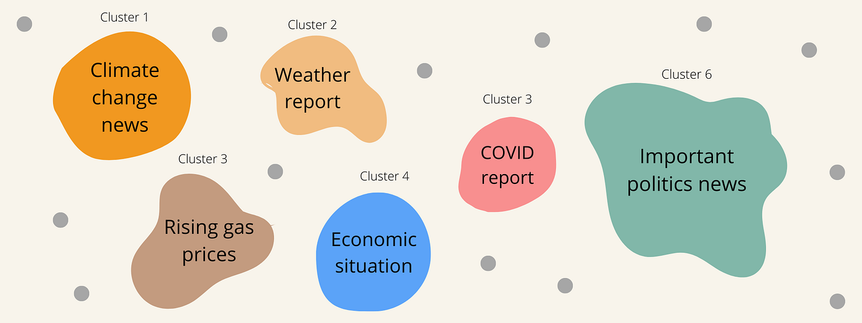
Categorizing news articles
Google News uses unsupervised learning to categorize articles on the same story from various online news outlets. For example, the results of a presidential election could be categorized under their label for politics news.

Slide 36
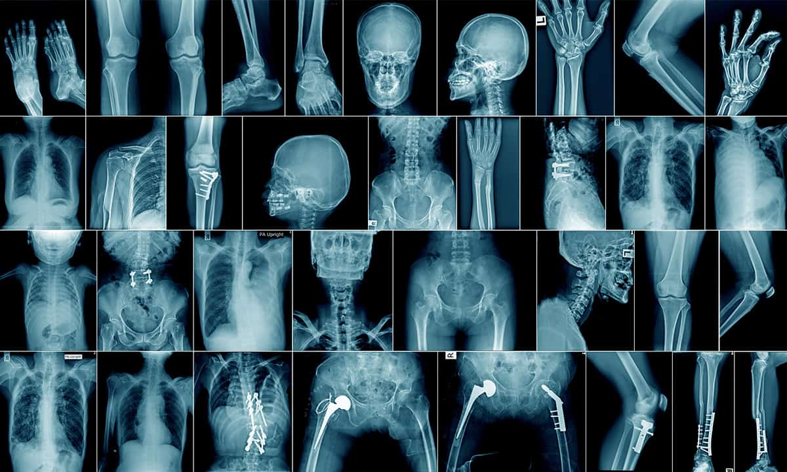
Medical Imaging
Unsupervised machine learning provides essential features to medical imaging devices, such as image detection, classification and segmentation, used in radiology and pathology to diagnose patients quickly and accurately.

Slide 37
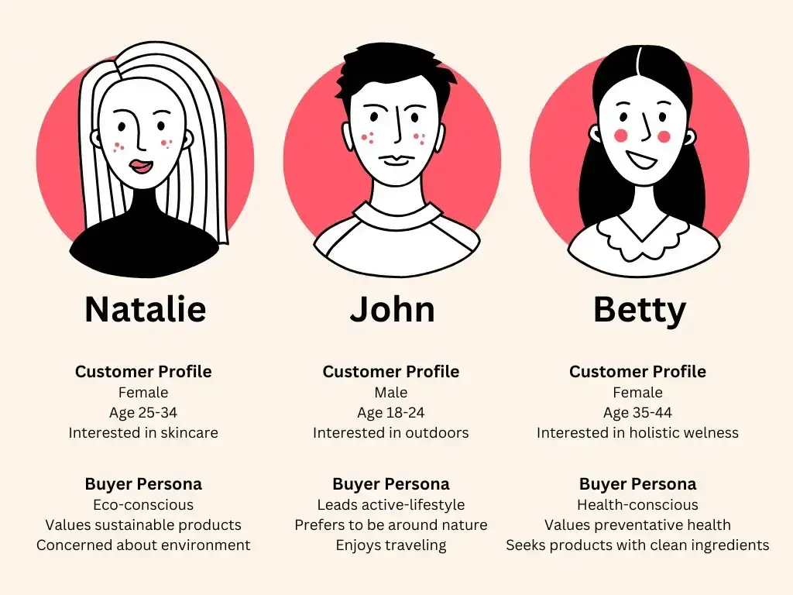
Customer Profiling
Defining customer personas makes it easier to understand common traits and business clients' purchasing habits. Unsupervised learning allows businesses to build better buyer persona profiles, enabling organizations to align their product messaging more appropriately.

Slide 38
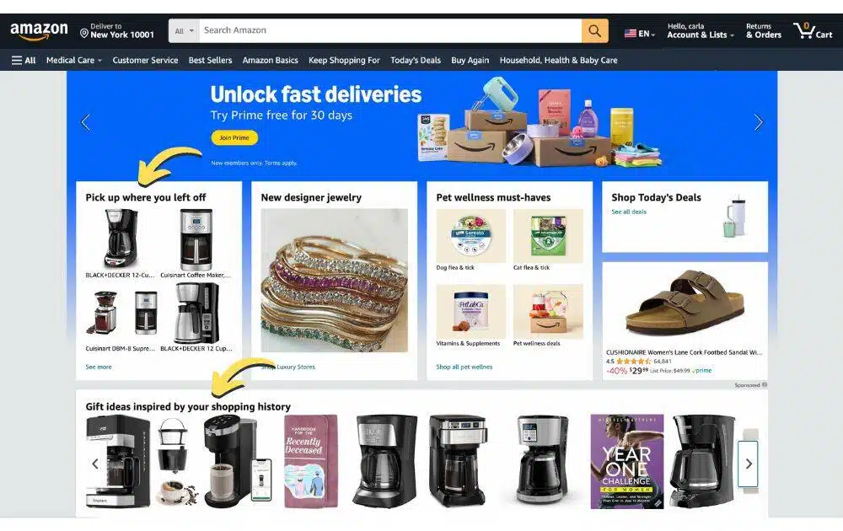
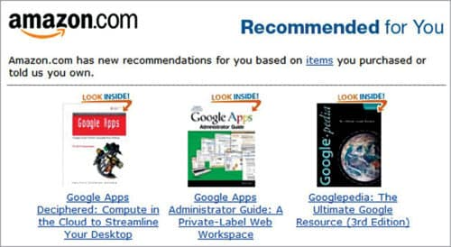
Recommendation Systems
Using past purchase behavior data, unsupervised learning can help to discover data trends that can be used to make relevant add-on recommendations to customers during the checkout process for online retailers.

Slide 39
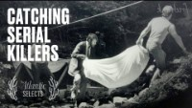
How clustering helped tracked a killer

Slide 40
References
https://www.ibm.com/think/topics/unsupervised-learning

